Slide 1
ITSC 206: LAN Networking for Offensive and Defensive Environments
Lecture 2: Secure the Local Area Network. (LAN)

Slide 2
Table of Contents
Review Lecture & Lab
MAC Address Spoofing
ARP Address Spoofing
VLAN Hopping
DHCP Starvation
DHCP Server Spoofing
IP Spoofing
STP Spoofing
Private VLan

Slide 3
Review Lecture & Lab

Slide 4
Review
Network Security
Threats
Defenses (Defense in Depth)
Wired vs Wireless Networks
Network Vulnerabilities
Security Toolbox
Lab: Architecture Review, Packet Investigation & Vulnerability Analysis

Slide 5
Threats, Vulnerabilities, Safeguards & Assets
Assets
Threat
Data
Facilities
Hw/Sw
Safeguards
Threat
Vulnerability
Threat
Safeguards

Slide 6
MAC Address Spoofing

Slide 7
MAC Address Spoofing
Very simple network attack technique
Attacking device can spoof a MAC address, registering itself as a different network node on the switch
This network attack technique serves as the basis for many higher-level network attacks
Including CAM overflow, ARP spoofing, DHCP starvation and DHCP server spoofing

Slide 8
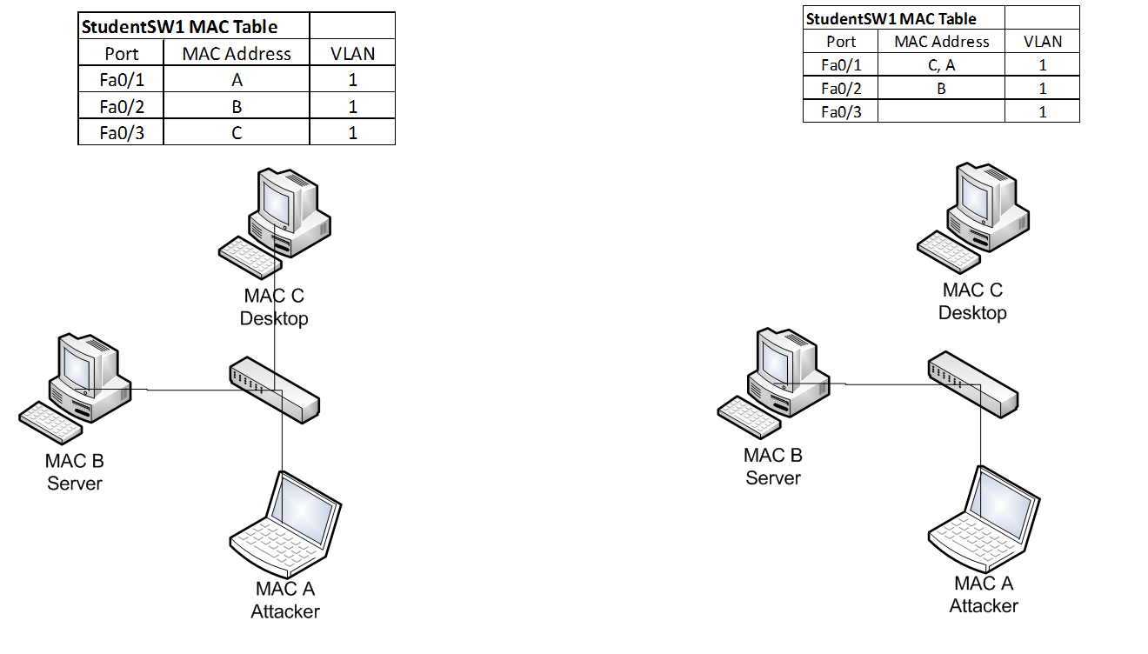
MAC Address Spoofing

Slide 9
MAC Address Spoofing Prevention
To mitigate MAC address spoofing:
Configure Port security on all access ports to limit the number of allowed MAC address registrations
Configure the violation types and the aging timers
Switch(config)# int range fa0/1-24
Switch(config-if-range)# switchport mode access
Switch(config-if-range)# switchport nonegotiate
Switch# show interfaces truck
Switch(config-if)# switchport port-security
Switch(config-if)# switchport port-security maximum 3
Switch(config-if)# switchport port-security mac-address sticky
Switch(config-if)# switchport port-security mac-address 0016.cb96.9594
Switch# switchport port-security violation {shutdown | restrict | protect}
Switch(config)#vlan 666
Switch(config)# int range fa0/2-24
Switch(config-if-range)# switchport access vlan 666

Slide 10
Discussion

Slide 11
ARP Spoofing

Slide 12
ARP Spoofing
Network attack designed to take over traffic for the targeted IP address (man-in-the-middle)
Relies on ARP protocol to associate the attacker’s MAC address to an IP address on the same LAN segment
Successful execution allows attacker to hijack network traffic for the targeted IP address
Particularly useful for spoofing a network gateway

Slide 13
ARP Spoofing
ARP spoofing builds on MAC address spoofing
Can be achived by sending specially crafted G-ARP packets to announce the MAC address for the target IP address on a particular network port
By repeatedly sending G-ARP packets, the MAC address is repeatedly associated with the attacker’s network port in the CAM table
Also, other hosts on the network intercept and store the attacker’s MAC address for the target IP address

Slide 14
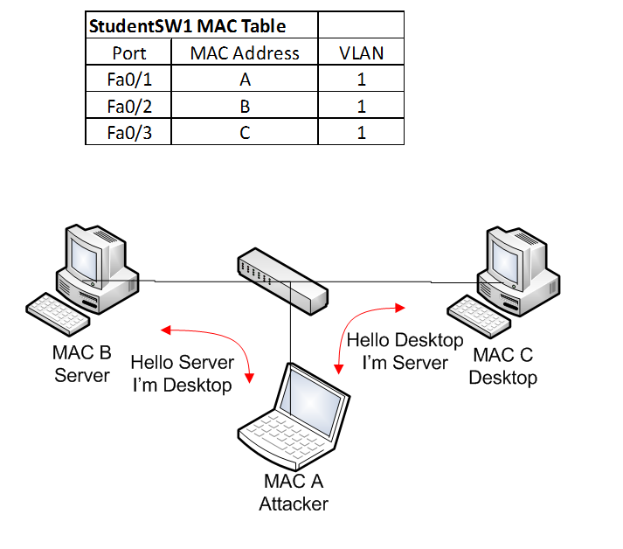
ARP Spoofing

Slide 15
ARP Spoofing Prevention
To mitigate ARP spoofing
Similar to MAC Spoofing Mitigation; and
Enable Dynamic ARP Inspection (DAI) on Switch
Intercepts all ARP requests (DHCP snooping) and responses on untrusted ports prevents a class of man-in-the-middle attacks
The switch drops ARP packet if the sender MAC address and sender IP address do not match an entry in the DHCP snooping bindings database
ip arp inspection vlan
Static ARP mappings.
A static mapping associates an IP address to a MAC address on a VLAN.
Useful when static IP addresses are used, DHCP snooping cannot be run, or other switches in the network do not run dynamic ARP inspection.

Slide 16
Discussion

Slide 17
VLAN Hopping

Slide 18
VLAN Hopping
A layer 2 network attack that targets the switch to gain access to a VLAN that is not accessible.
2 Types of attacks:
Posing as a switch connected with a VLAN trunk,
Double-tagging a VLAN to “hop” to another VLAN.

Slide 19
VLAN Hopping via Trunk Port
Posing as a switch, the attacking device can request the switch port to negotiate a trunk using Dynamic Trunking Protocol (DTP)
Once a trunk is established, the connected device can send and receive different VLAN traffic
Can access restricted VLANs (e.g., management VLAN)
This type of network attack is effective with physical access to the LAN environment

Slide 20
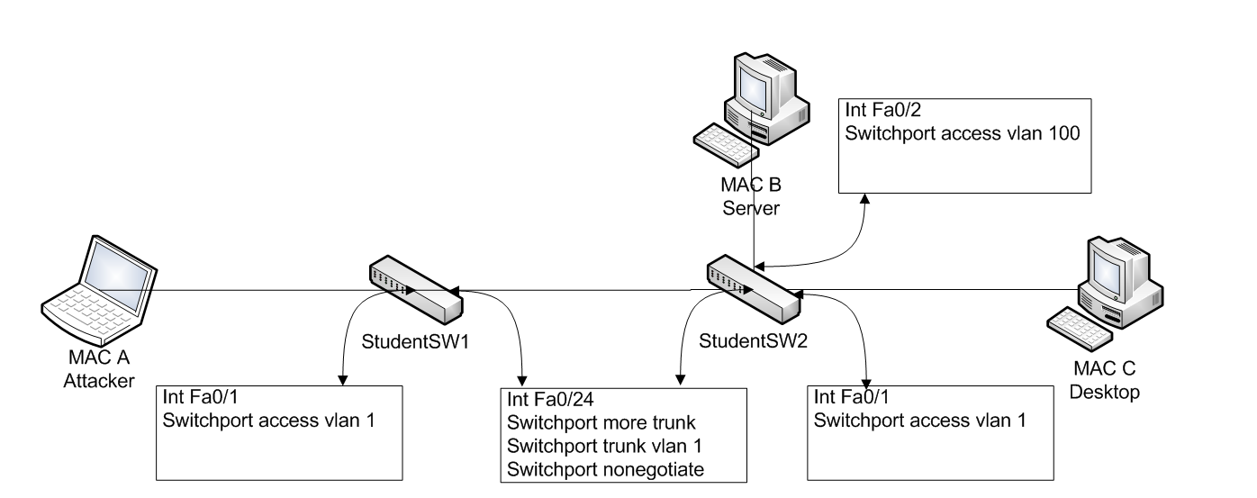
VLAN Hopping via Trunk Port

Slide 21
VLAN Hopping via Double Tagging
The double tagging attack is when connected to an interface in access mode with the same VLAN as the native untagged VLAN on the trunk.
The attacker sends a frame with two 802.1Q tags, the “inner” VLAN tag is the VLAN that we want to reach and the “outer” VLAN tag is the native VLAN.
When the switch receives the frame, it will remove the first (native VLAN) 802.1Q tag and forwards the frame with the second 802.1Q tag on its trunk interface(s).
The attacker has now “jumped” from the native VLAN to the victim’s VLAN. It’s a one way trip but it could be used perhaps for a DOS attack.

Slide 22
VLAN Hopping via Double Tagging
Tag
20
IP
Switch 1
Switch 2
IP
Tag
1, 20
IP
Attack Device
Victim
Device
VLAN 1
VLAN 20

Slide 23
VLAN Hopping Prevention
To mitigate VLAN hopping via trunk port:
Similar to MAC Spoofing Mitigation; and
Do not put any hosts on VLAN 1 (the default VLAN);
Change the native VLAN on all trunk ports to an unused VLAN ID;
Explicit tagging on the native VLAN on all trunk ports.

Slide 24
Discussion

Slide 25
DHCP Starvation

Slide 26
DHCP Starvation
Network attack targeting the exhaustion of a DHCP client IP from an authorized DHCP server
Using MAC address spoofing, an attacking device sends large numbers of DHCP requests using different “fake” MAC addresses
Once exhausted, the network DHCP server no longer has an available DHCP client IP to offer
This causes a Denial of Service (DoS) on the target network
DHCP starvation also serves as the basis of DHCP server spoofing attacks

Slide 27
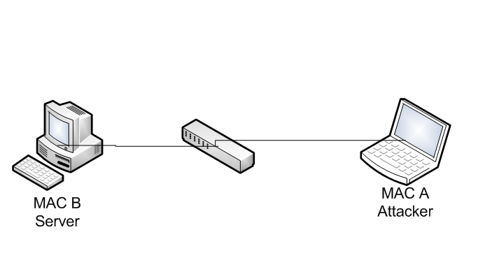
DHCP Starvation

Slide 28
DHCP Starvation Prevention
To mitigate a DHCP starvation attack
Similar to MAC Spoofing Mitigation; and
Enable DHCP snooping on switch to prevent an unauthorized DHCP server from responding to DHCP requests

Slide 29
Discussion

Slide 30
DHCP Server Spoofing

Slide 31
DHCP Server Spoofing
Network attack a rogue DHCP server poses as a legitimate DHCP server for the network segment
Since the DHCP server provides network gateway, DNS information, WPAD configuration, etc.,
DHCP server spoofing is the basis for many other higher-level network attacks, such as gateway spoofing, DNS spoofing and proxy spoofing

Slide 32
DHCP Server Spoofing
DHCP server spoofing relies on DHCP starvation attacks
If DHCP starvation attack is successful, the legitimate DHCP server no longer offers DHCP client IPs
The rogue DHCP server starts offering DHCP servers on the network from its own pool of IP addresses (typically from the exhausted pool of IPs obtained from the DHCP starvation attack)

Slide 33
DHCP Server Spoofing

Slide 34
DHCP Server Spoofing Prevention
To mitigate DHCP server spoofing
Similar to MAC Spoofing Mitigation; and
Enable Port security on switch, limits the number of MAC addresses connected to switch port
The attack relies on DHCP starvation attacks, mitigating DHCP starvation attacks also mitigates DHCP server spoofing
Enable DHCP snooping on switch to prevent an unauthorized DHCP server from responding to DHCP requests

Slide 35
Discussion

Slide 36
IP Spoofing

Slide 37
IP Spoofing
Network attack to hijack another IP address
Can hijack traffic destined for the target host
Builds on ARP spoofing to be successful
Attacker can repeatedly send G-ARP for a target IP address and redirects IP traffic to the attacker’s port
In its simplest form, attacker can change the IP address of a host and cause an IP address conflict (and DoS) on the target IP

Slide 38
IP Spoofing

Slide 39
IP Spoofing
To mitigate an IP spoofing attack
Similar to MAC Spoofing Mitigation; and
Use IP Source Guard to further restrict IP spoofing

Slide 40
Discussion

Slide 41
Spanning Tree Protocol Spoofing

Slide 42
Spanning Tree Protocol Spoofing
Network attack that changes the STP topologies to force network traffic to traverse a rogue network device
By controlling the rogue network device, attacker can sniff all passing network traffic and perform man-in-the-middle attacks

Slide 43
Spanning Tree Protocol Spoofing
Uses a rogue network device to pose as the ROOT bridge in a STP network
By injecting BPDU frames with the lowest priority, the rogue network device can become the elected ROOT bridge and change the topology in a STP network
Network traffic begins flowing through the ROOT bridge, allowing sniffing and man-in-the-middle attacks

Slide 44
STP Spoofing

Slide 45
STP Spoofing Prevention
To mitigate STP spoofing
Similar to MAC Spoofing Mitigation
Configure network ports with BPDU guard and ROOT guard
Configure non-trunk ports to switch access ports

Slide 46
Discussion

Slide 47
Private VLAN

Slide 48
Private VLAN
A private VLAN is used to provide additional segregation between all network hosts within the same VLAN
Especially useful for sensitive data servers that require port isolation to established secure hosting
A private VLAN includes Primary VLAN, Secondary VLAN (isolated and community), Promiscuous port, Isolated port and Community port

Slide 49
Private VLAN
 | Isolated Port | Promiscuous Port | Community Port
Isolated Port | Deny | Permit | Deny
Promiscuous Port | Permit | Permit | Permit
Community Port | Deny | Permit | Permit

Slide 50
Discussion

Slide 51
© 2017, Southern Alberta Institute of Technology. All rights reserved.
This publication and materials herein are protected by applicable intellectual property laws. Unauthorized reproduction and distribution of this publication in whole or part is prohibited.
For more information, contact:
Director, Centre for Instructional Technology and Development
Southern Alberta Institute of Technology
1301 16 Ave. N.W., Calgary, AB T2M 0L4

